Slide 1
Marketing Strategies to Launch a New Product
By: Team A
Prajwal Ghotage I1
Shradha Patil I2
Rahul Patil I3
Sakshi Jadhav I4
Rachana Narvekar I5
Navjeet Kohli I6

Slide 2
Contents:
Product Features
Social Media Marketing
Digital Marketing
Special Offers
Conclusion

Slide 3

Just A Rather Very Intelligent System

Slide 4






What can JARVIS do for you?
Make Calls
Navigate for you
Book an uber
Voice control your home
Play it for you
Manage texts

Slide 5
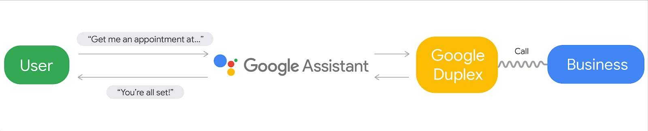
What Makes JARVIS Different?
JARVIS Duplex: An AI system for accomplishing Real-World tasks over the phone.
It can essentially make calls for you, but with a natural-sounding human voice instead of a robotic one.
JARVIS Duplex

Slide 6
Social Media Marketing
Social media marketing, or SMM, is a form of internet marketing that involves creating and sharing content on social media networks in order to achieve your marketing and branding goals.
Social media marketing includes activities like posting text and image updates, videos, and other content that drives audience engagement, as well as paid social media advertising.
Social media is a great tool to target the right audience and become a well known brand.

Slide 7
Goals to achieve through social media
Increasing website traffic
Raising brand awareness
Creating a brand identity and positive brand association
Improving communication and interaction with key audiences

Slide 8
Steps towards achieving the goals
Creating profiles on the best and most famous social media platforms like-
Facebook
Instagram
Twitter
Reddit
Creating a huge and loyal following on all the social media platforms.
Keeping track of our competitors.
Measuring our products success through Analytics.

Slide 9
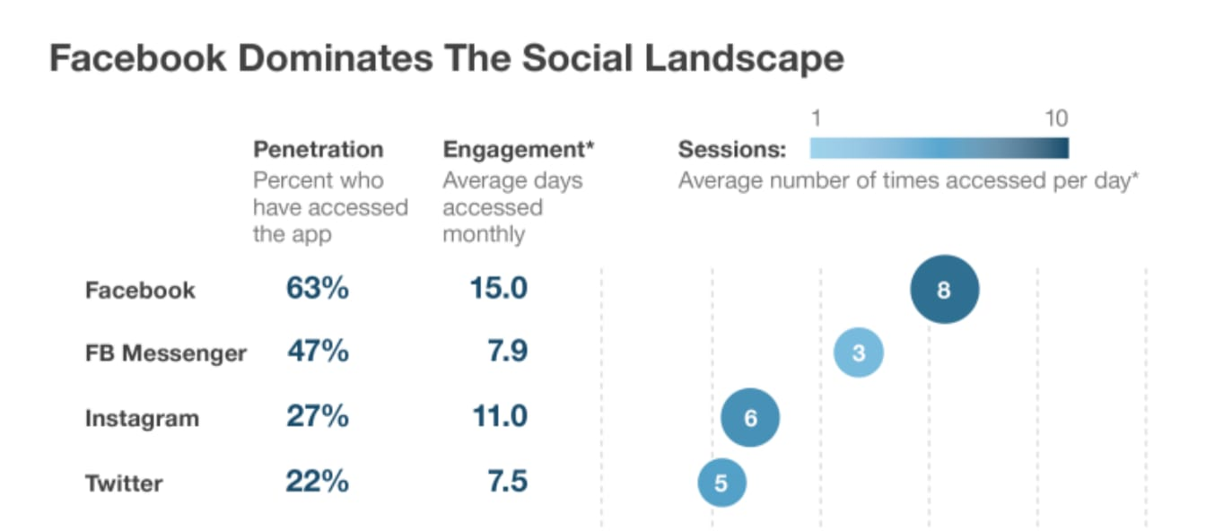

Slide 10
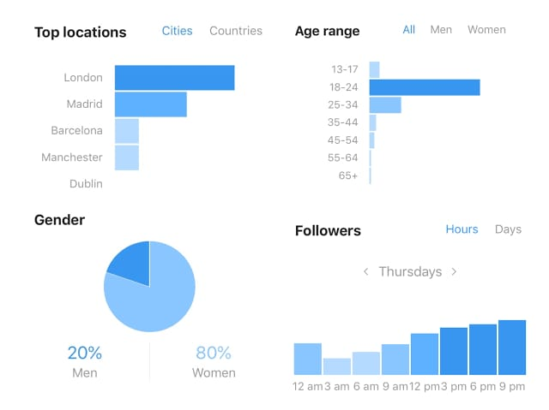

Slide 11
Website
24/7 customer support
Information exchange
Designing website
Portfolio
Feedback

Slide 12
Marketing through Advertisements and videos on YouTube
YouTube video marketing needs to appeal to your audience on an emotional level.
The ad should capture the attention of audience in the first 5 seconds or they will lose interest.
Effective marketing can also be done by creating viral YouTube videos, although it is easier said than done.
The videos can be small, funny or be emotional. But it must be something that the audience can connect to and hence be interested in the product.

Slide 13
Sponsoring major Youtubers and TechTubers
Sponsoring big and influential YouTubers for product promotion.
Providing free review units to major TechTubers to rouse interest in both the product and company.
This can involve incorporating the product in some way into their videos to promote it in their audience.
Providing affiliate links to purchase the product with a discount, out of which for each purchase a small amount is transferred to the YouTuber.

Slide 14
Search Engine Optimization [SEO]
SEO is a fundamental part of digital marketing and it is the one which helps us in improving our site to increase its visibility when people search for products or services related to our business in Google, Bing, and other search engines.
In sum, SEO is the foundation of a holistic marketing ecosystem. When we understand what our website users want, we can then implement that knowledge across our campaigns (paid and organic), across our website, across our social media properties, and more.

Slide 15
Pay Per Click [PPC]
PPC marketing is a way of using search engine advertising to generate clicks to our website, rather than “earning” those clicks organically. You know those sponsored ads we often see at the top of Google’s search results page, marked with a yellow label ; That’s pay-per-click advertising (specifically Google Ads PPC).
Pay-per-click marketing is good for everyone:
It’s good for searchers
It’s good for advertisers
It’s good for search engines

Slide 16
Special Offers
Credit card offer
Points Card
Extended warranty
Cashback offer
Referrals

Slide 17
Conclusion
Launching a new product is always a challenge for any company no matter what it is. As long as we are creating something that will in turn help the customer and make their life a lot easier ; with the right marketing strategy it could possibly be a success.
It is like explosion of information,the expansion of technology,and the aggressiveness of competition,at all levels and everywhere.

